Slide 1
Python Inheritance Type : Hybrid PART - 5
In Tamil
By
Monisha S

Slide 2
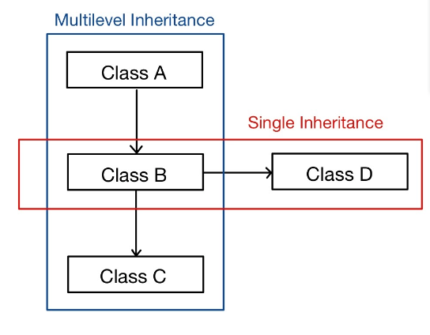
Hybrid Inheritance
Inheritance consisting of multiple types of inheritance is called hybrid inheritance.

